Slide 1
The C Programming Language
Yi Wang 王祎

Slide 2
About the course
Instructor: Yi Wang, 27398718@qq.com
Teaching assistants (TAs): in QQ group
Office hours: 信息楼 319 (upon request, emails are preferred)
Slides: QQ group
Homework submission: Practice hours
Grading: 30% (Assignments & class participation) + 70% (Final exam)

Slide 3
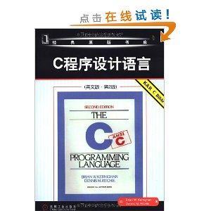
Textbook and references
References
B.W. Kernighan and D.M. Ritchie.
The C Programming Language. China Machine Press. “C Bible”
蒋光远、田琳琳 编. 《C程序设计快速进阶大学教程》. 清华大学出版社
E. Balagurusamy. 《Programming in ANSIC C》. Tshinghua Press.
Stephen Prata. C Primer Plus. Addison-Wesley Educational Publishers Inc.

Slide 4
Rules
Silent cell phones
Laptop OFF
Be absent 3 times OR late/early(leave) 5 times → absent to final exam
Questions are welcome, but one person talking
No plagiarism (copy) for homework

Slide 5
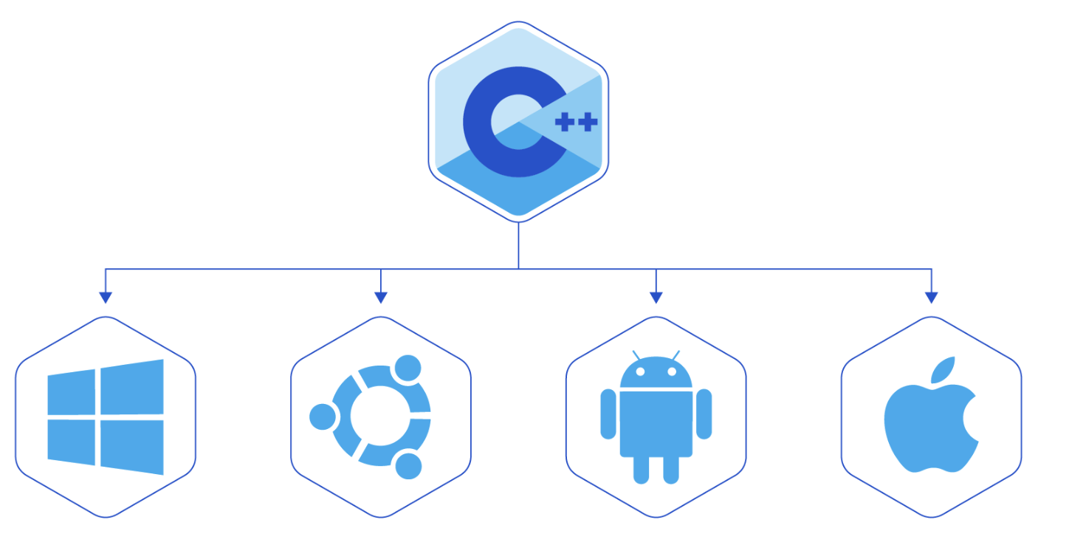
Why programming
After all these Years, the World is Still Powered by C Programming
Many of the C projects that exist today were started decades ago.
Microsoft Windows
Microsoft’s Windows kernel is developed mostly in C, with some parts in assembly language. For decades, the world’s most used operating system, with about 90 percent of the market share, has been powered by a kernel written in C.

Slide 6
Linux
Linux is also written mostly in C, with some parts in assembly. About 97 percent of the world’s 500 most powerful supercomputers run the Linux kernel. It is also used in many personal computers.
Mac
Mac computers are also powered by C, since the OS X kernel is written mostly in C. Every program and driver in a Mac, as in Windows and Linux computers, is running on a C-powered kernel.
Mobile
iOS, Android and Windows Phone kernels are also written in C. They are just mobile adaptations of existing Mac OS, Linux and Windows kernels. So smartphones you use every day are running on a C kernel.

Slide 7
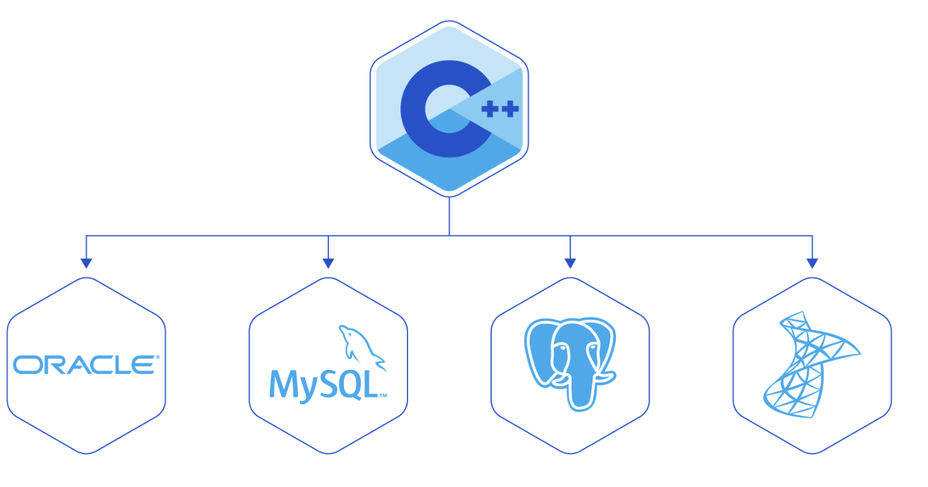
Databases
The world’s most popular databases, including Oracle Database, MySQL, MS SQL Server, and PostgreSQL, are coded in C (the first three of them actually both in C and C++).
Databases are used in all kind of systems: financial, government, media, entertainment, telecommunications, health, education, retail, social networks, web, and the like.

Slide 8
Why C Programming?
Provide efficiency compared with Java
Widely used in developing video/image and graphics processing algorithms, in which a large amount of computation is involved.
Provide low-level access to memory
Widely used in the development for embedded systems such as industrial control systems, mobile phones and networking devices.
Provide transparency (immigration) across platforms (Unix, Windows and iOS)
https://www.toptal.com/c/after-all-these-years-the-world-is-still-powered-by-c-programming
https://zhuanlan.zhihu.com/p/50552507

Slide 9
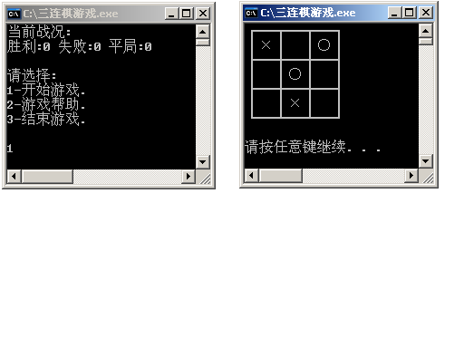
三连棋游戏
基于控制台的简单版本

Slide 10

三连棋游戏
基于MFC的进阶版本

Slide 11
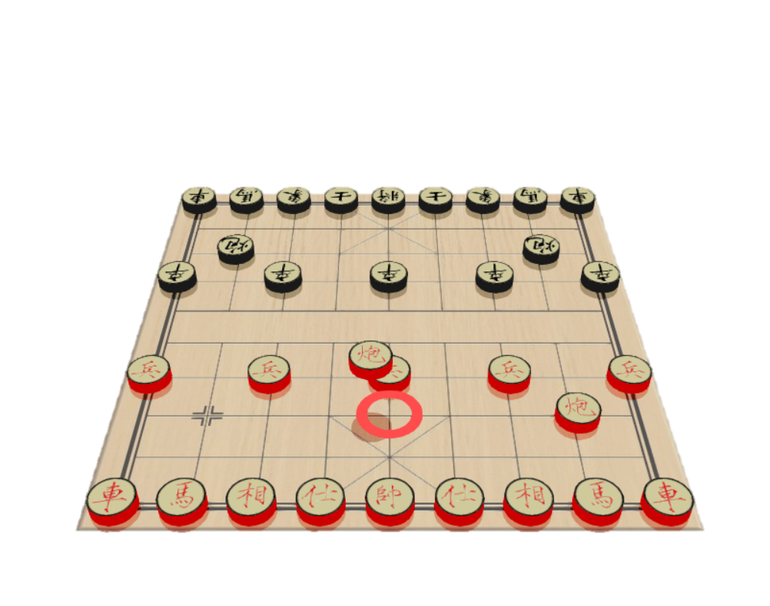
基于OpenGL的3D中国象棋

Slide 12
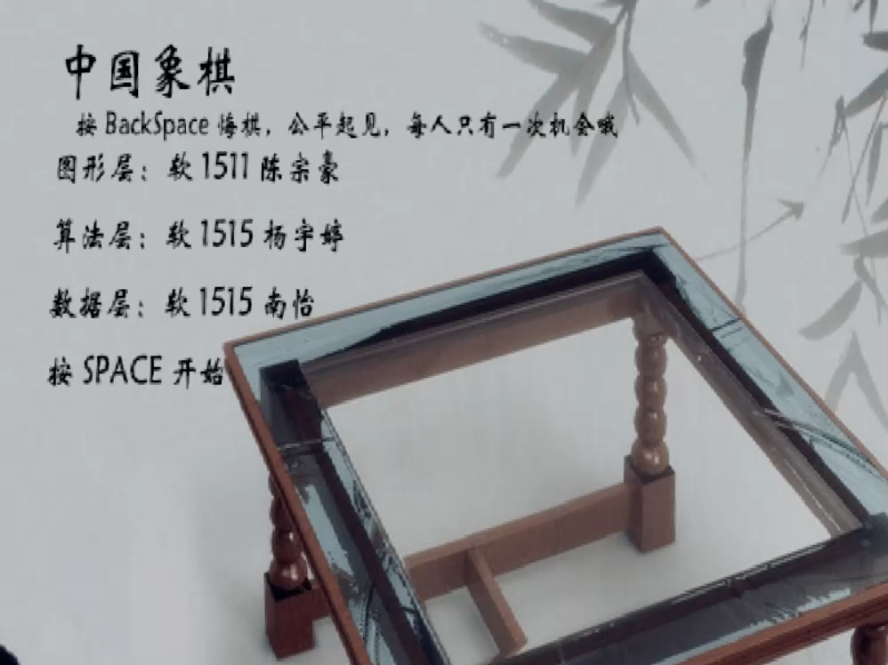
游戏录制视频
点击画面播放

Slide 13
Adding two numbers
#include <stdio.h>
Chap2:
Data type
, operators
, expressions
int Add(int i1, int i2)
{
return (i1+i2);
}
Chap3: Control flow
Chap4: Functions
Chap5: Pointers and arrays
main ()
{
Chap6: User-defined types
Chap7: Input and output
int x, y, z;
x = 5;
y = 10;
z = x + y;
z = Add(x, y);
User-defined functions
if (z >0)
printf(“The sum is positive: %d”, z);
Library functions
else
printf(“The sum is non-positive: %d”, z);
}
Main function: a stand alone program has and only has ONE main function.

Slide 14
Program structure
A program consists of one or more functions, one of which must be the main function main()
#include <stdio.h> ------ file header
int main(void) ------ function header
{
int q; ------declaration statement
q=1; ------assignment statement
printf("%d is neat. \n", q); ------function call
return 0; ------function return
}
Function body

Slide 15

Main functions
The main is a part of every C program. C permits different forms of main statement. Following forms are allowed.
No arguments, nor return value
main()
void main()
main(void)
void main(void)
No arguments, but returns an integer
int main()
int main(void)
Two arguments
int main (int argc, char *argv[])
Notes:
arguments 参数

Slide 16
Developing cycle of C
Edit
Compile
Link
Execute
Edit
Write readable texts and save as files named after ‘XX.c’.
Compile
Convert to object files ‘.obj’ that are binaries (0101).
Link
Link ‘obj’ files and library files together to an executable file (.exe).
Execute (test)
Run the EXE file and debug (find and correct errors).

Slide 17
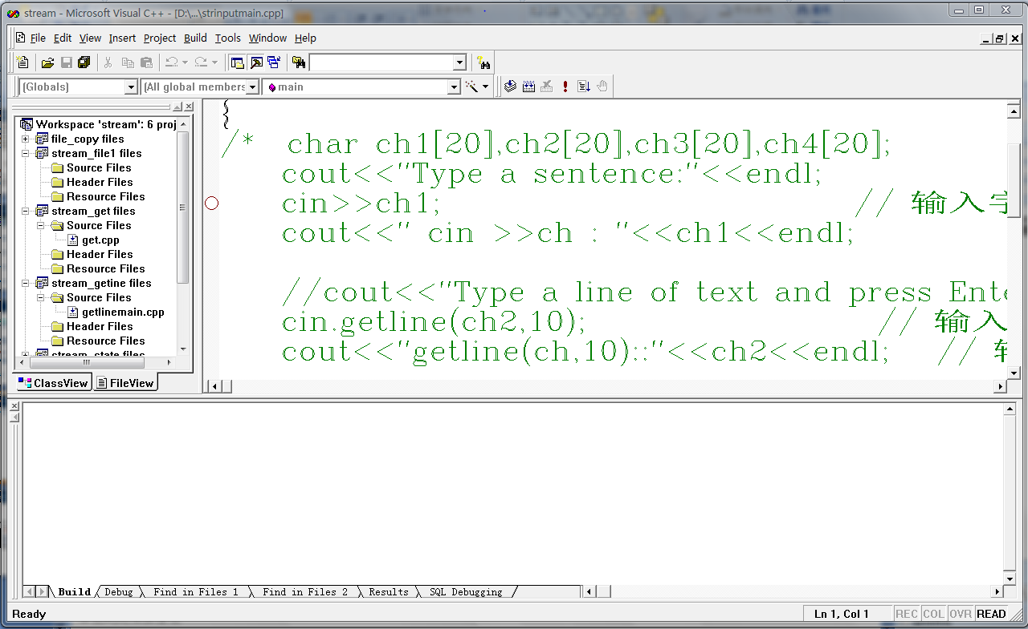
Using Integrated Development Interface (IDE)
Write and test ‘Hello world program’ using Visual C++
IDE Windows
Menu
Caption bar
Toolbars
Workspace window
Editing widnow
Output window
Status bar

Slide 18
Workspace and projects in VC
Workspace (Collection of related projects)
Project
Project
…
main() function
main() function
A stand alone program
User-defined functions
User-defined functions
Library functions

Slide 19
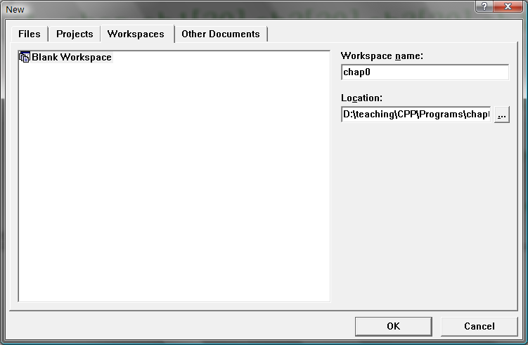
Create a workspace and project
File → new (Ctrl+N)→ ‘Workspace’ tab

Slide 20
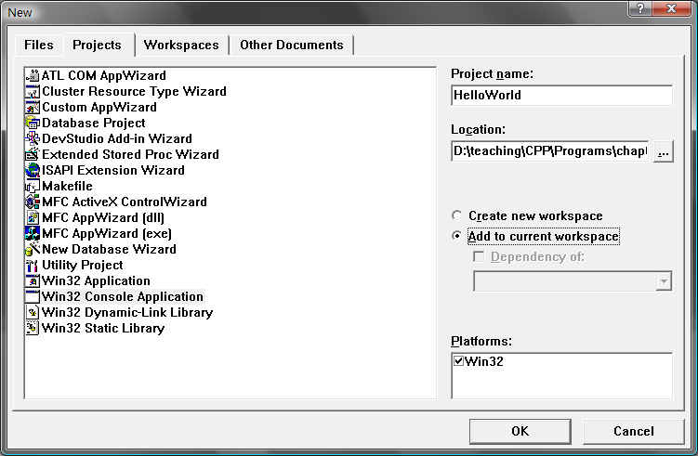
Create a workspace and project
File → new (Ctrl+N)→ ‘Projects’ tab
‘Win32 Console Application’
Notes:
console

Slide 21
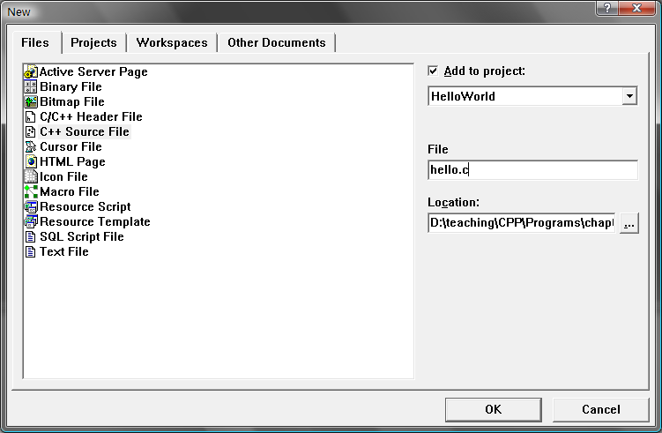
Create source files
File → new (Ctrl+N)→ ‘Files’ tab
‘C++ Source File’
Type in a name ending with ‘.c’

Slide 22
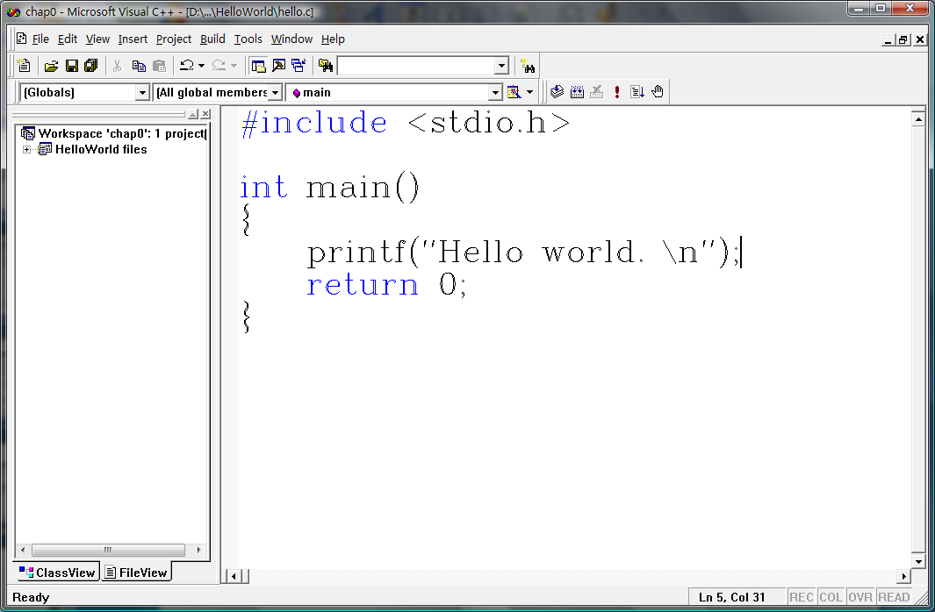
Type in programs

Slide 23
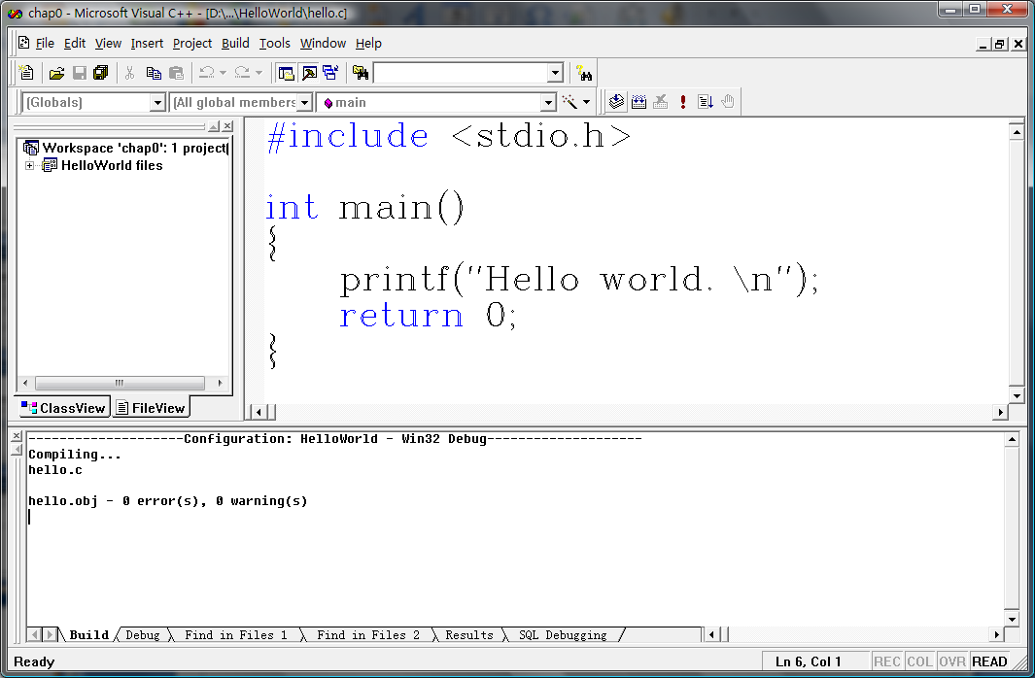
Compile
Build → Compile Filename.c (Ctrl+F7)
Click ‘compile’ button in ‘Build bar’

Slide 24
Link
Build→ Build Projectname.exe (F7)
Click ‘build’ button in ‘build’ bar

Slide 25
Execute
Build→ Execute Projectname.exe (Ctrl+F5)
Click ‘Execute’ button in ‘build’ bar

Slide 26
Flow chart of developing C
Start
Edit
.C
Source Program
Compile
Y
Errors?
.OBJ
Object Program
N
System Library and Other Object Program
Link
Y
.EXE
Executive Program
Errors?
N
Execute
N
Result Right？
Y
Process
End

Slide 27
Bugs and Debugging
Syntax（语法） errors
Syntax errors of English
I loves C.
Joy C loves.
Syntax errors of C
#include <stdio.h>
int main(void)
{
int n, int n2, int n3; //错了
n=5;
n2 = n*n;
n3=n2*n2;
printf("n=%d, n squared =%d, n cubed=%d", n, n2, n3)
return 0;
}

Slide 28
Bugs and Debugging
Semantic（语意） errors
Semantic errors of English
Joy loves C. -- correct
C loves Joy.
Syntax errors of C
#include <stdio.h>
int main(void)
{
int n, n2, n3;
n=5;
n2 = n*n;
n3=n2*n2; //错了
printf("n=%d, n squared =%d, n cubed=%d", n, n2, n3);
return 0;
}

Slide 29
Bugs and Debugging
Brain debugger
int n, n2, n3; --Variable initialization
n=5; --Variable n set to 5
n2 = n*n; --Variable n2 set to n squared
n3=n2*n2; --Variable n3 set to n2 squared
?
?
?
n
n2
n3
5
?
?
n
n2
n3
5
25
?
n
n2
n3
5
25
625
n
n2
n3
Tip: use printf wherever necessary

Slide 30
Bugs and Debugging
Computer debugger
Set break point
Run step by step (F8) or ‘Step into’
Run to cursor
Check memory
…
Tip: read the manual of IDE or just try

Slide 31
Exercise - 1
Consider the following program
#include <stdio.h>
int main(void)
{
int a, b;
a=5;
b=2; /*line 7*/
b=a; /*line 8*/
a=b; /*line 9*/
printf(“%d, %d\n", b, a);
return 0;
}
What is the program state after line 7? Line 8? Line 9?

Slide 32
Exercise - 2
Consider the following program
#include <stdio.h>
int main(void)
{
int x, y;
x=10;
y=5; /*line 7*/
y=x+y; /*line 8*/
x=x*y; /*line 9*/
printf(“%d, %d\n", b, a);
return 0;
}
What is the program state after line 7? Line 8? Line 9?

Slide 33
作业
看看这个C语言程序设计.浙江大学.翁恺老师的mooc中文的 https://www.bilibili.com/video/BV1Bx411u7qY?from=search&seid=12711010823689150651
P1-P7节

